Slide 1
Instructions for Use
Using These Slides to Present to Students:
You will be meeting with students who have learned the basics of Falling Stars
They are challenged with the following task:
-Design a probe, drop a probe and measure the amount of time in the air
-Analyze and compare their data
Change slides to be about you! Keep it simple as the students will be lost in the details.
Anywhere you see curly brackets { } replace the information with your own words.
Replace images with images of your work. (Reminders are in the speaker notes)
Before you begin: Make a copy of this slide deck to edit yourself.

Slide 2
Hello!
I AM {insert Name and title}
I study {insert area of expertise}
Notes:
*Be sure to change your picture
*Photo Credits from unsplash: https://unsplash.com/photos/50TkCaP8M3A?utm_source=unsplash&utm_medium=referral&utm_content=creditShareLink

Slide 3
{Field of Study}
This is the study of {Include a brief summary of what you study here}

Slide 4
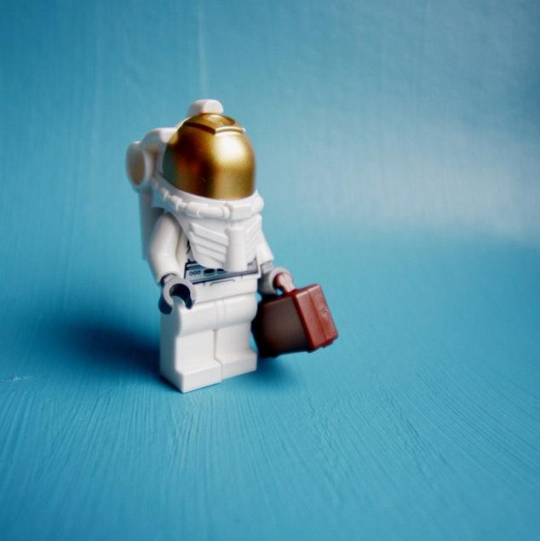
My Research
{A picture is worth a thousand words. A complex idea can be conveyed with just a single still image. Use this area to write one sentence describing the image}
Notes:
*Be sure to change image to one of your doing your science or an image of what you work on (ie image of a rover or rocket that you have worked on).

Slide 5
Falling Stars
{How do scientists work together during the Life Cycle of a Satellite? Include a brief summary about how collaboration is an important part of your work at The Aerospace Corporation}
Notes:
Credits
Presentation template by SlidesCarnival
Photographs by Unsplash

Slide 6
My Research Goals
{Use this area to write one sentence describing the long term goal of your work.}
Notes:
*Be sure to change image to another (different) one of your doing science or an image of what you work on (ie image of a satellite or parts that you have worked on).

Slide 7
Thanks!
ANY QUESTIONS?
You can find me at @username & user@mail.me
Notes:
Credits
Presentation template by SlidesCarnival
Photographs by Unsplash

